Slide 1
The Airbnb Investment in Washington D.C

Slide 2

hello!
Abdulrahman ALQunaibt
& Essam Khawaji
We are here to present our recommendations for investment in Washington

Slide 3
Should our investor invest in an Airbnb hotel in Washington, D.C.?
If so, in which neighborhood should they invest?

Slide 4
Asking the right questions is a fundamental step in the analysis process to produce reliable results

Slide 5
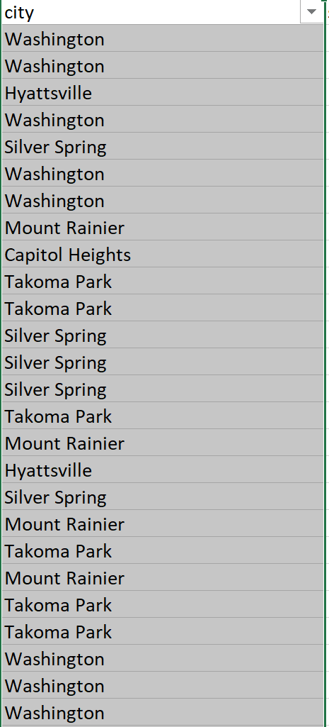
Data analysis steps:
Remove the Duplicates.
Exclude non-Washington D.C values.
Identify the columns related to the desired results.
Apply the analysis steps and use appropriate functions.

Slide 6
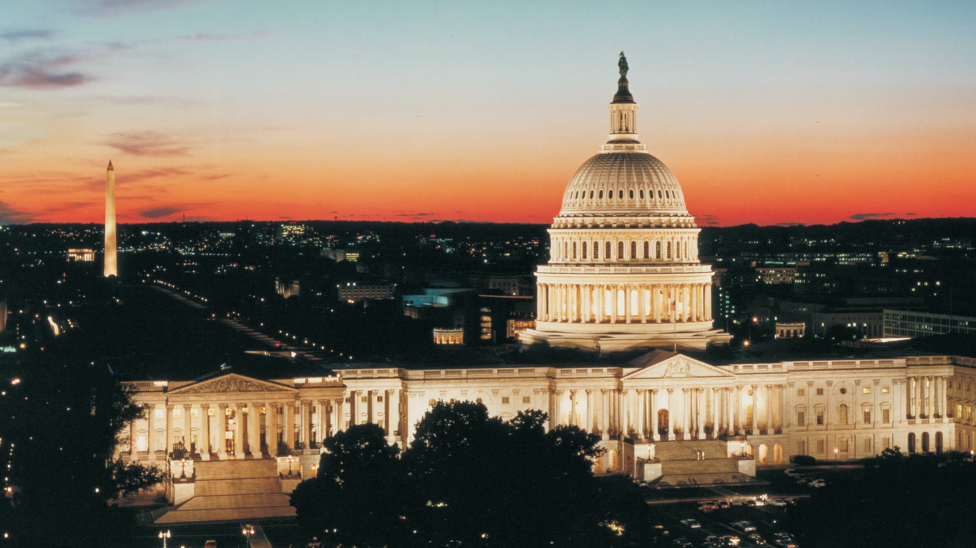

Washington D.C figures
Washington D.C figures

Slide 7
45,457,910
The size of the Washington D.C market, That’s a big number

Slide 8
551,504
3724 listing
113,612 Stays
That’s a lot of money per day
And a lot of customers
Success!

Slide 12
Interesting comparisons
 | Stays | Daily Revenue | Total Revenue
Capitol Hill | 279 | S43,875 | $727,515,6
Dupont Circle | 163 | $22,635 | $426,986,8
Columbia Heights | 209 | $26,088 | $315,313,8

Slide 13
Recommendations
We believe that Capitol Hill is the best neighborhood to invest in.

Slide 14
thanks!
Misk foundation.
General Assembly.
Any questions?
?

